Slide 1

Big
Data
Analytics
G. Sudha Sadasivam & R. Thirumahal

Slide 2

Chapter 12
Text Processing

Slide 3
Agenda
Steps in text processing
Text processing using R
Applications
Topic modeling
Sentimental Analysis
Sentimental Analysis using R

Slide 4
Introduction
Text analysis explores unstructured textual data to extract useful insights in the form of concepts, patterns, keywords
Once data is organized, data processing is performed to extract useful information, discover relationships, and identify patterns
It is an iterative process
Process involves the following steps:
a) Document collection (Corpus): the text for analysis (unstructured) has to be downloaded/imported.
b) Parsing : converts unstructured document collections into structured format suitable for analysis
Tokenization It is the process of dividing a sentence into words using separators N-Gram model or the Bag of Words model is an example of this approach.
Part-of-speech (PoS) tagging of tokens with different parts of speech, such as verbs, determiners, nouns, and prepositions.
Stop word removal like ‘a’, ‘the’, and ‘an’

Slide 5
Introduction
Lemmatization finds the correct dictionary base form of a word.
Identification of synonyms for a given word.
Stemming extracts the root/stem of a word using porter's stemming algorithm
C) Transformation: converts the document into a bag of words using approaches like term frequencies and SVD it extracts keywords, phrases, topics, and concepts
D) Feature selection: as the dimensionality of text data is high, this phase eliminates irrelevant features (words).
E) Text mining uses methods and techniques like Clustering, classification, prediction, and summarization to draw insights.
F) Evaluation computes the efficiency of the process by using metrics such as recall, precision, and accuracy, among others.

Slide 6
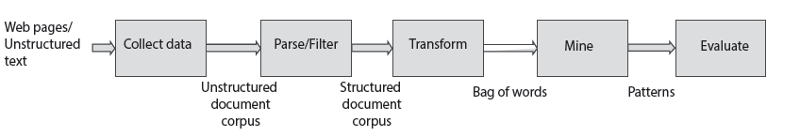
Introduction

Slide 7
Applications
Risk management software used by banks to identify the credibility of its account holders to give loans
Spam filtering intelligent text analytics can be used along with statistical techniques to filter spam mail from email boxes.
Personalized advertisements to suitable customers is done by analysing their purchase behavior, emails, tweets, etc. Content-based /collaborative filtering is used along with intelligent text analytics.
Business intelligence aids decision making for successful business. Eg Market analysis , visualization techniques
Content enrichment Text mining techniques can be used to extract relevant documents that can be used to create novel content by the content writer.
Customer care services using the customer behavior improves customer experience , saves time and money.
Maintaining health records in electronic form facilitates easy transfer and analysis of information

Slide 8
Case Study
1) Collection of document corpus in various formats like csv, xls, xml, json using readtext command into a text file . It can be converted to lowercase, all characters other than alphabets removed
filepath<-"https://raw.Githubusercontent.com/...../inaugCorpus.Csv"
>rt <- readtext(filepath, text_field = "texts")
>x <- stri_replace_all(rt, "", regex = "<.*?>")
>x <- stri_trans_tolower(x)
2) Preprocessing
Extract tokens
>library(quanteda)
>Token_list<-tokens(x)
Stemming
>Stemmed_toks<- tokens_wordstem(token_list)
Stop word removal
>sw<-stopwords("english")
>tokens_remove(stemmed_toks, sw)
This is an example file.
This is an example file
this is an example file
This, is, an, example, file.
This, is, an, exampl, file.
exampl, file.

Slide 9
Case Study
3) Transformation:
a) Document-term matrix represents the frequency in which a particular term occurs in a document. Document feature matrix (dfm) function in the ‘quanteda’ package can be used to create a document-term matrix from raw text
text<- c(d1 = “An Apple a day keeps the doctor away",
+ D2 = “Apple iphone has a facinating user interface but iphone is costly", .. d4
>dtm<- dfm(text, # input text
+ Tolower = TRUE, stem = TRUE, # set lowercasing and stemming to TRUE
+ remove = stopwords("english")) # provide the stopwords for deletion
b) Term frequency gives the importance of a term in a document. However, if the same term occurs in many documents, it may not be a feature of a particular document. Hence, inverse document frequency (IDF) is also considered.
Corpus C, document d, and term t.
TFIDF(t, d, C) = TF(t, d ) × IDF(t, C)
IDF (t, C) = # documents / # documents with term c

Slide 10
Case Study
Form transpose of tdm as matrix with rows as terms and cols as doc
>tdm<-t(dtm)
>tf<- as.Matrix(tdm)
Find idf vector as # cols / # freq of terms
idf<- log( ncol(tf) / ( 1 + rowSums(tf != 0)))
Transform IDF vector to diagonal matrix
>( idf<- diag(idf) )
>tf_idf<- crossprod(tf, idf)
>colnames(tf_idf) <- rownames(tf)
Normalise by length of document
>tf_idf / sqrt(rowSums( tf_idf^2 ) )
4) feature selection: Textir package can be used to select the 10 important features.
>colnames(tf_idf)[
+ order(-sdev(tfidf(tf_idf)))[1:10]]

Slide 11
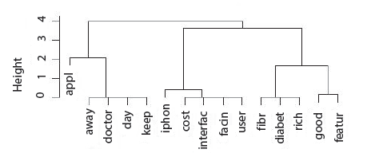
Case Study
5) Text Mining: Hierarchical Clustering can be done for example using cosine similarity
cos.sim<- function(ix)
+ { A = tf_idf[ix[1],]
+ B = tf_idf[ix[2],]
+ Return( sum(A*B)/sqrt(sum(A^2)*sum(B^2)) ) }
>n <- nrow(tf_idf)
>cmb <- expand.grid(i=1:n, j=1:n)
> C <- matrix(apply(cmb,1,cos.sim),n,n)
Hierarchical Clustering
>cosine_dist = 1-crossprod(tf_idf) /(sqrt(colSums(tf_idf^2)%*%t(colSums(tf_idf^2))))
>cosine_dist[is.na(cosine_dist)] <- 0
>cosine_dist<- as.dist(cosine_dist)
>cluster1 <- hclust(cosine_dist, method = "ward.D")
>plot(cluster1)

Slide 12
Topic Modeling
Topic modeling is a statistical technique that identifies the abstract topics in a document corpus
LDA is one technique
Treats a doc as a collection of topics with a mixture of words
So relative importance of topics in the documents, and the words in the topics is inferred iteratively
Let C= {d1, d2,…, dn} with w words and K topics
Assign each word in the document corpus to one of the K topics temporarily.
Iteratively repeat the procedure by finding the conditional probability of A given B ((P(A|B)).
Let topic assignments, except for the current word ‘w’ be correct, update the assignment of the current word ‘w’ to a new topic by evaluating the score P(t|d ) × P(w|t).

Slide 13
Sentiment Analysis
Sentiments are settled opinions on one's feelings and can be expressed by the subject on the object, either explicitly or implicitly
It can be at document, sentence or phrase level
Steps include:
Data collection from social media sites, product / movie reviews,
Data preparation with features extraction and selection
Consider the term frequency based on the TF-IDF score.
n-grams are considered as considering position of the word
POS tagging with adjectives and adverbs to extract sentiments.
Identify negation of phrases by integrating it with PoS tags.
Find the semantic orientation of words using WordNet
Semantic orientation of sentences and documents have to be identified.

Slide 14
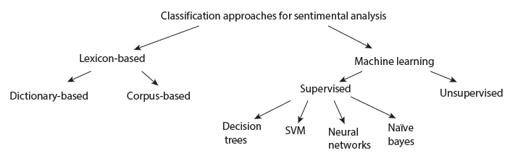
Sentiment Analysis
c) Building model using ML or PoS approaches
Lexicon-based approach uses a list of words from dictionary that specify various sentiments..
Machine learning unsupervised learning and supervised learning methods such as Naïve Bayes classifier, neural networks, SVM, and decision trees, Text classification methods
d) Train and update This involves enhancing the model built with the extracted knowledge.

Slide 15
Applications
Monitoring the performance of a product using social media and product reviews
Providing better Customer Service by analysing content of mails
Analysing the trends, ideologies, and opinions in the fields of politics, sociology, and opinions
Predicting the market demand and price fluctuations of a product
Sentiment analysis can be used in the following fields:
Business: In the marketing field, the customers' feelings towards a product or brand can be analysed.
Politics: In the political field, it is used to keep track of the political view, It can be used to predict election results as well.
Public actions: Sentiment analysis is also used to monitor and analyse social phenomena, for the spotting of potentially dangerous situations and determining the general mood of the blogosphere.

Slide 16
Sentimental Analysis using R
Rsentiment, sentimental analysis, and machine learning.
Rsentiment pkg identifies sentiments in a text and classifies them into six categories
Calc_total_presence finds no of sentences in each category
Calculate_score finds the sentiment score
Calculate_sentiment finds sentiment of a sentence
Sentiment Analysis pkg is used to find sentiment of a text (eg acq). It also allows plotting of sentiments and summarization
> sentiment <- analyzeSentiment(acq)
>class(sentiment$NegativityLM)
[1] "numeric"
>table(convertToBinaryResponse(sentiment$SentimentLM))
negative positive
26 24
Machine learning using quanteda ansde1071pkg.
Pos, ned and test sentences are to be stored in an array
Native bayes’ classifier is trained
Testing is done with test sentences

Slide 17
Conclusion
Steps in text processing
Text processing using R
Applications
Topic modeling
Sentimental Analysis
Sentimental analysis using R

Slide 18
Thanks!

